Slide 1


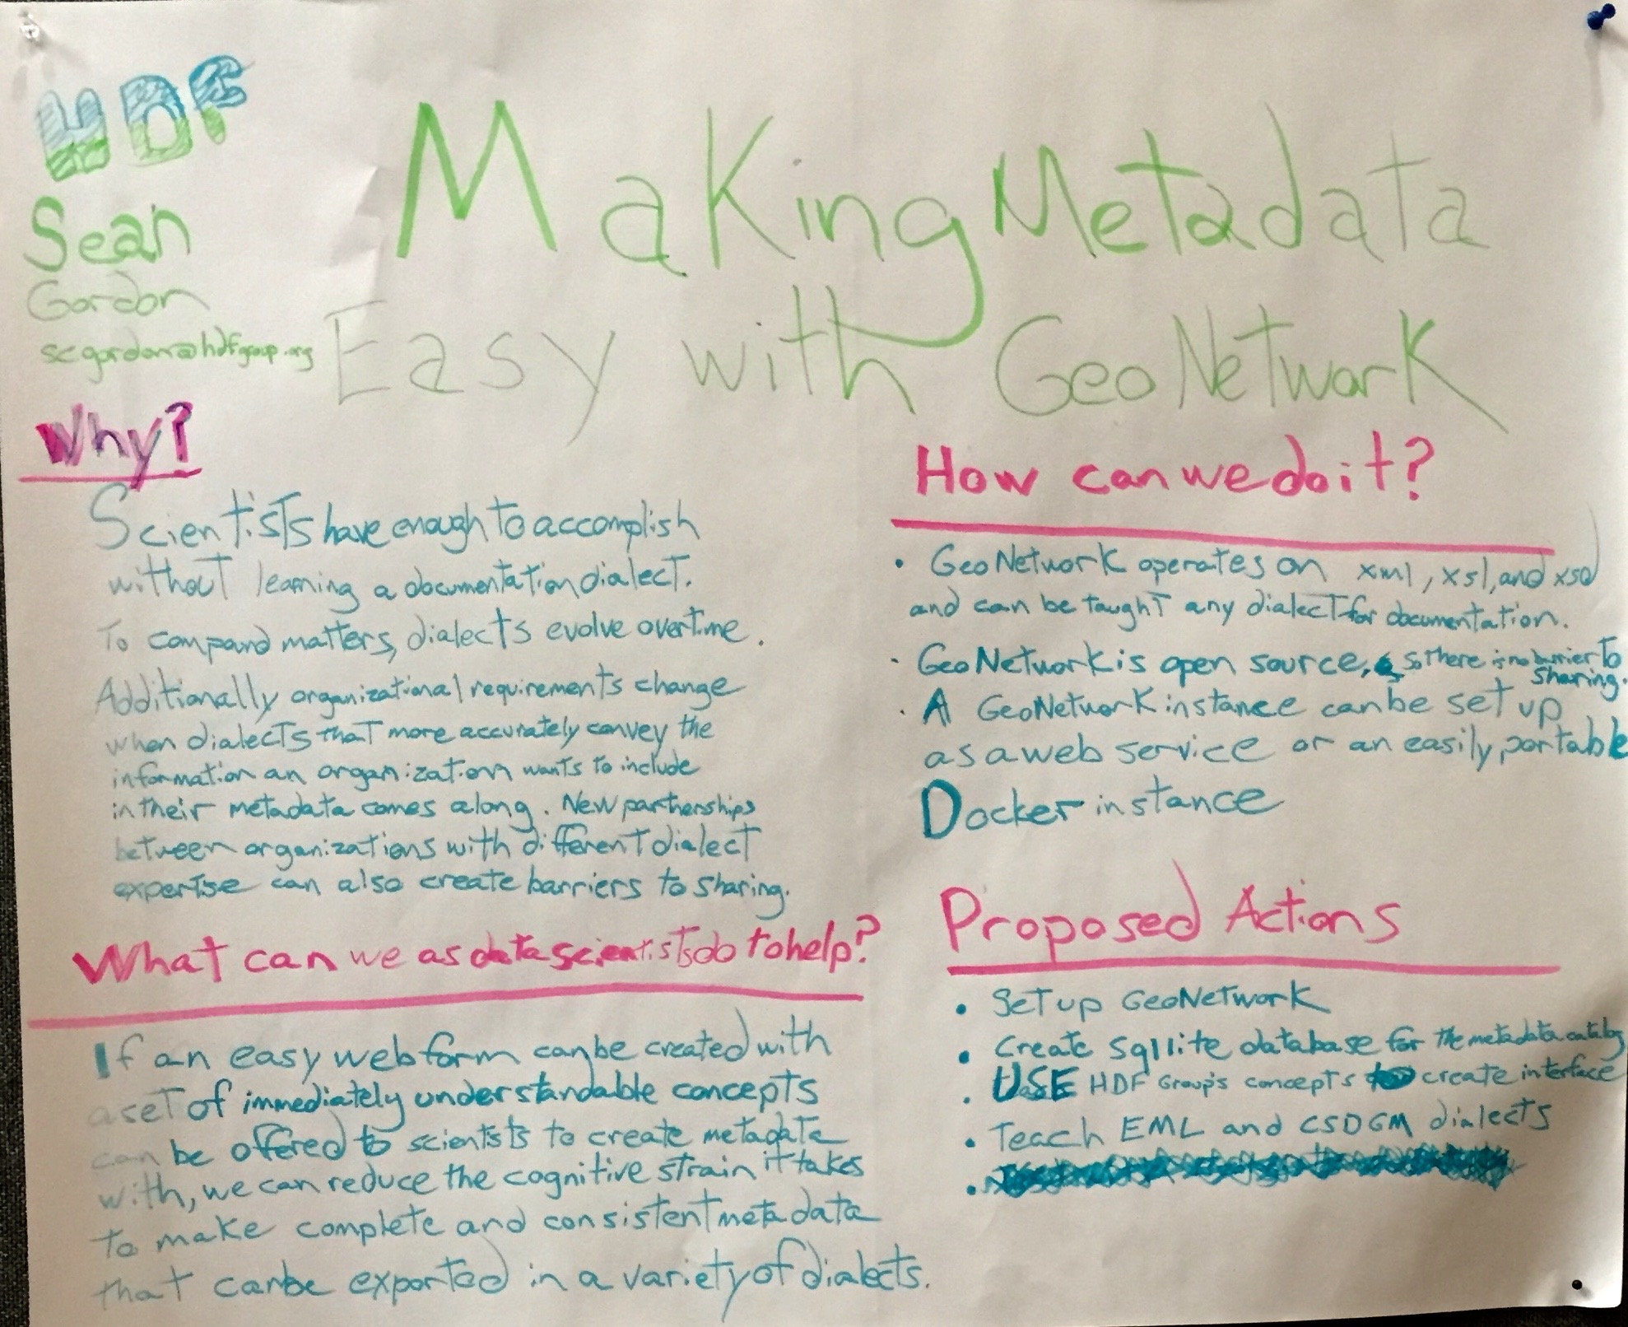














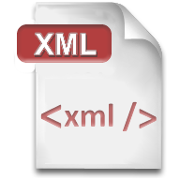



Making Metadata Easy
A Recommendations Based Approach To Documentation using GeoNetwork
Sean Gordon
(scgordon@hdfgroup.org)
Proposal
GeoNetwork is a standards based editor and catalog
Community recommendations facilitate quality metadata
Standards based documentation can be difficult to write well
Simple, editable webforms
Statement Of Work
Tasks
Create GeoNetwork instance
Explore integration of the Ecological Metadata Language and the Content Standard for Digital Geospatial Metadata dialects and HDF concepts
Create webform for a recommendation using HDF concepts.
Make and edit metadata
Deliverables
Poster Presentation at 2017 ESIP Winter Meeting
https://goo.gl/0SmYSI
https://goo.gl/TBg5zT
Process
Research GeoNetwork, read documentation
Use Github to build a development instance of the application
Focus on integration of recommendations into editor using views
Implement a schema plugin for ISO 19115-3
Use ISO 19115-3 as template dialect
Alter ISO 19115-3 schema plugin to display HDF concept names and descriptions
Utilize Open Science Framework and Github to document and share research
Find transforms to facilitate ingest and export in other dialects
Explore possibility of using export API to create collections analysis workflows and dialect selection
Toolkit
Workflow
Clone and branch
core-geonetwork
Clone and branch
metadata101/ISO_19115-3
Create
FUNding Friday MME repository
Results
Supports ingest of DataCite, CSDGM, DIF, ECHO, ISO 19115, ISO 19115-2, ISO 19115-3, and Dublin Core
Transforms to ISO 19115-3 or ISO 19115 on ingest which can then be transformed to ISO 19115-3 for editing
Created views for the ISO 19115-3 for Data Discovery as well as DataCite
Implement a schema plugin for ISO 19115-3
Use ISO 19115-3 as template dialect
Alter ISO 19115-3 schema plugin to display HDF concept names and descriptions
Utilize Open Science Framework and Github to document and share research
Find transforms to facilitate ingest
Explore possibility of using export API to create collections analysis workflows and dialect selection
OSF
Create FUNding Friday
project, document builds, process, SOW…
Combine Repos,
add customizations
XML, XSD, and
XSL for customization
What’s next?
Build export workflows that integrate Quick Evaluation, Translation Proofing, and RAD analyses
Collect community dialect transforms for ingest (dialect into ISO 19115-X
Collect and build community transforms for export (ISO 19115-3 to dialect)
Find hosting to offer the FUNding Friday GeoNetwork as a service
Automate creation of recommendation views from HDF AllCrosswalks to facilitate continuous integration
Create fork to make FUNding Friday MME easily accessible
Find funding to accomplish these tasks
Why not…
Ingest EML?
Export CSDGM or EML?
Why not Docker?
Why not SQLite?
FUNding Friday: Making Metadata Easy
Funding Friday and ESIP are supported by
and 170+ member organizations

Slide 2

Making Metadata Easy
A Recommendations Based Approach To Documentation, Creation, Curation, And Analysis Using Geonetwork
FUNding Friday
Proposal
GeoNetwork is a standards based editor and catalog
Community recommendations facilitate quality metadata
Standards based documentation can be difficult to write well
By combining recommendations and GeoNetwork a webform can created for different recommendations
Statement Of Work
Tasks
Create GeoNetwork instance.
Explore integration of the Ecological Metadata Language and the Content Standard for Digital Geospatial Metadata dialects and HDF concepts.
Create webform for a recommendation using HDF concepts.
Make and edit metadata.
Deliverables
Poster Presentation at 2017 ESIP Winter Meeting.
https://goo.gl/0SmYSI
https://goo.gl/TBg5zT
Process
Research other GeoNetwork instances
Focus on integration of recommendations into editor
Implement a schema plugin for ISO 19115-3
Utilize Open Science Framework and Github to document and share research
Eye with QR code
shrtLink.url
Funding Friday and ESIP is supported by
and 170+ member organizations

